Slide 1
Graph-QL
Resource exhaustion

Slide 2
Resource Exhaustion (DoS)
GraphQL does not provide any inherited mechanism to prevent an user to create huge queries, or use redundancy to create complex statement that the application will have trouble to serve, till it crashes.

Slide 3
What’s on our app

Slide 4

Architecture

Slide 5
Users table
uuid | username
1 | jhondoe
2 | jimcarry

Slide 6
Posts Table
uuid | title | body | author_id
1 | Hello World | … | 1
2 | Wooow | … | 2
3 | Second post | … | 1

Slide 7
1 User - > N Posts

Slide 8
1 Post -> 1 User

Slide 9
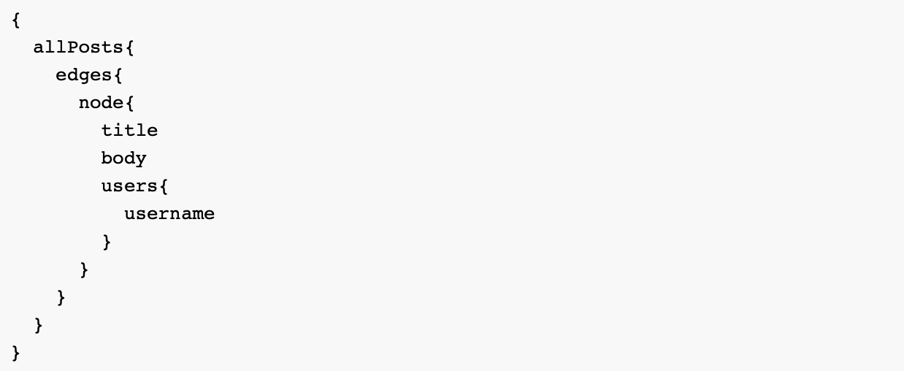
GraphQL query (all Posts)

Slide 10
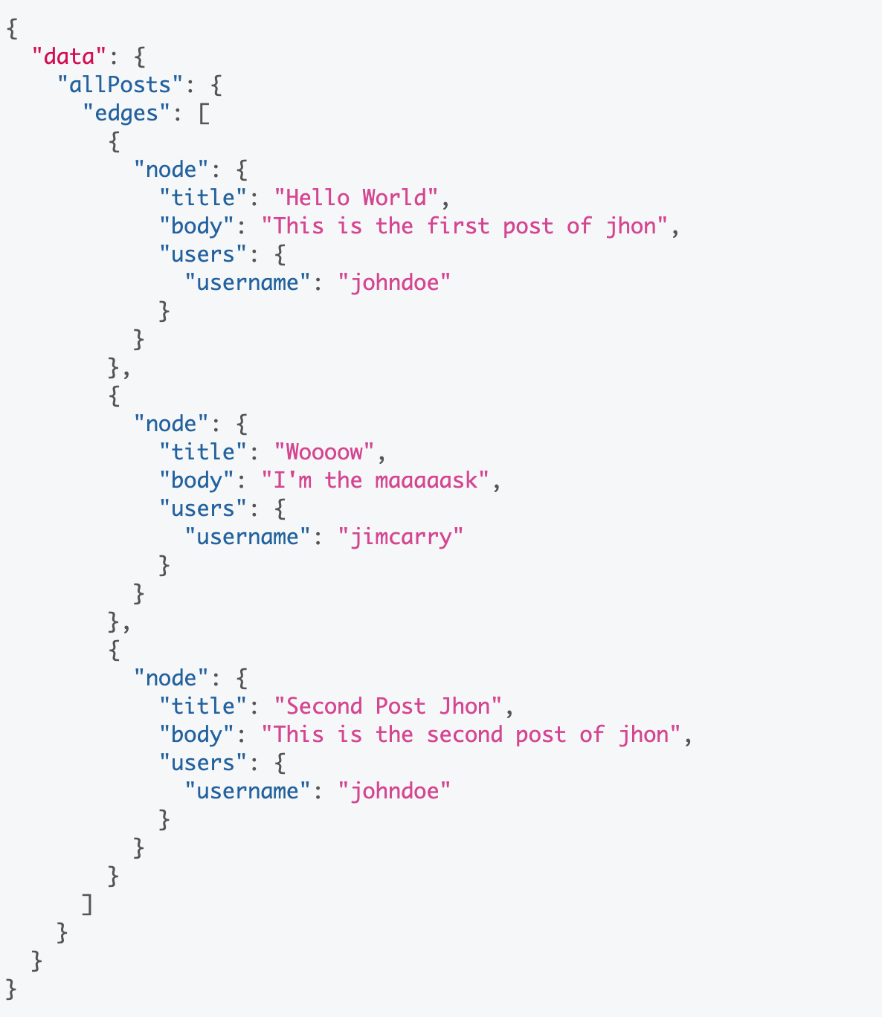
Response (all Posts)

Slide 11
What can go wrong?

Slide 12
DEMO

Slide 13
Let’s fix it

Slide 14
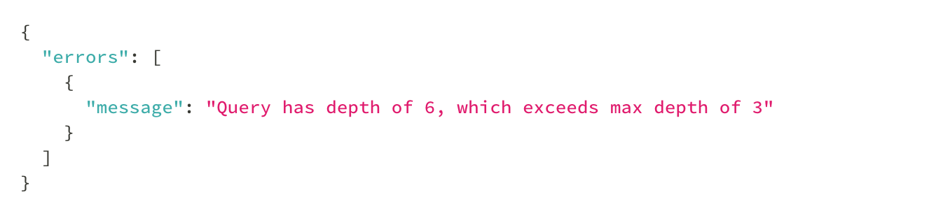
Fix 1: Limit the Maximum Query Depth

Slide 15
Limit Maximum Query Depth
Pros
Because the AST is statically analyzed the query is never executed
Cons
It’s very difficult to cover all the possible query combinations

Slide 16
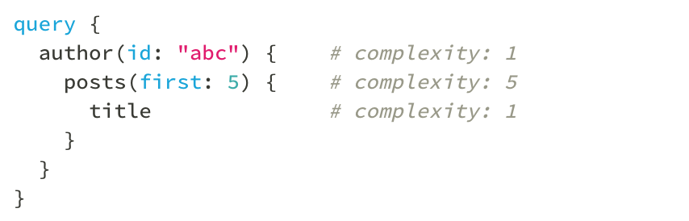
Fix 2: Calculate Query Complexity
Allow only low query complexity. If we set query complexity to 4 this query would fail

Slide 17
Calculate Query Complexity
Pros
Covers more scenarios
Do not execute the query
Cons
Hard to maintain
Difficult to calculate
Mutations can be tricky :/

Slide 18
Fix 3: Throttling Based on Server Time

Slide 19
Audit your query before production

